Slide 1
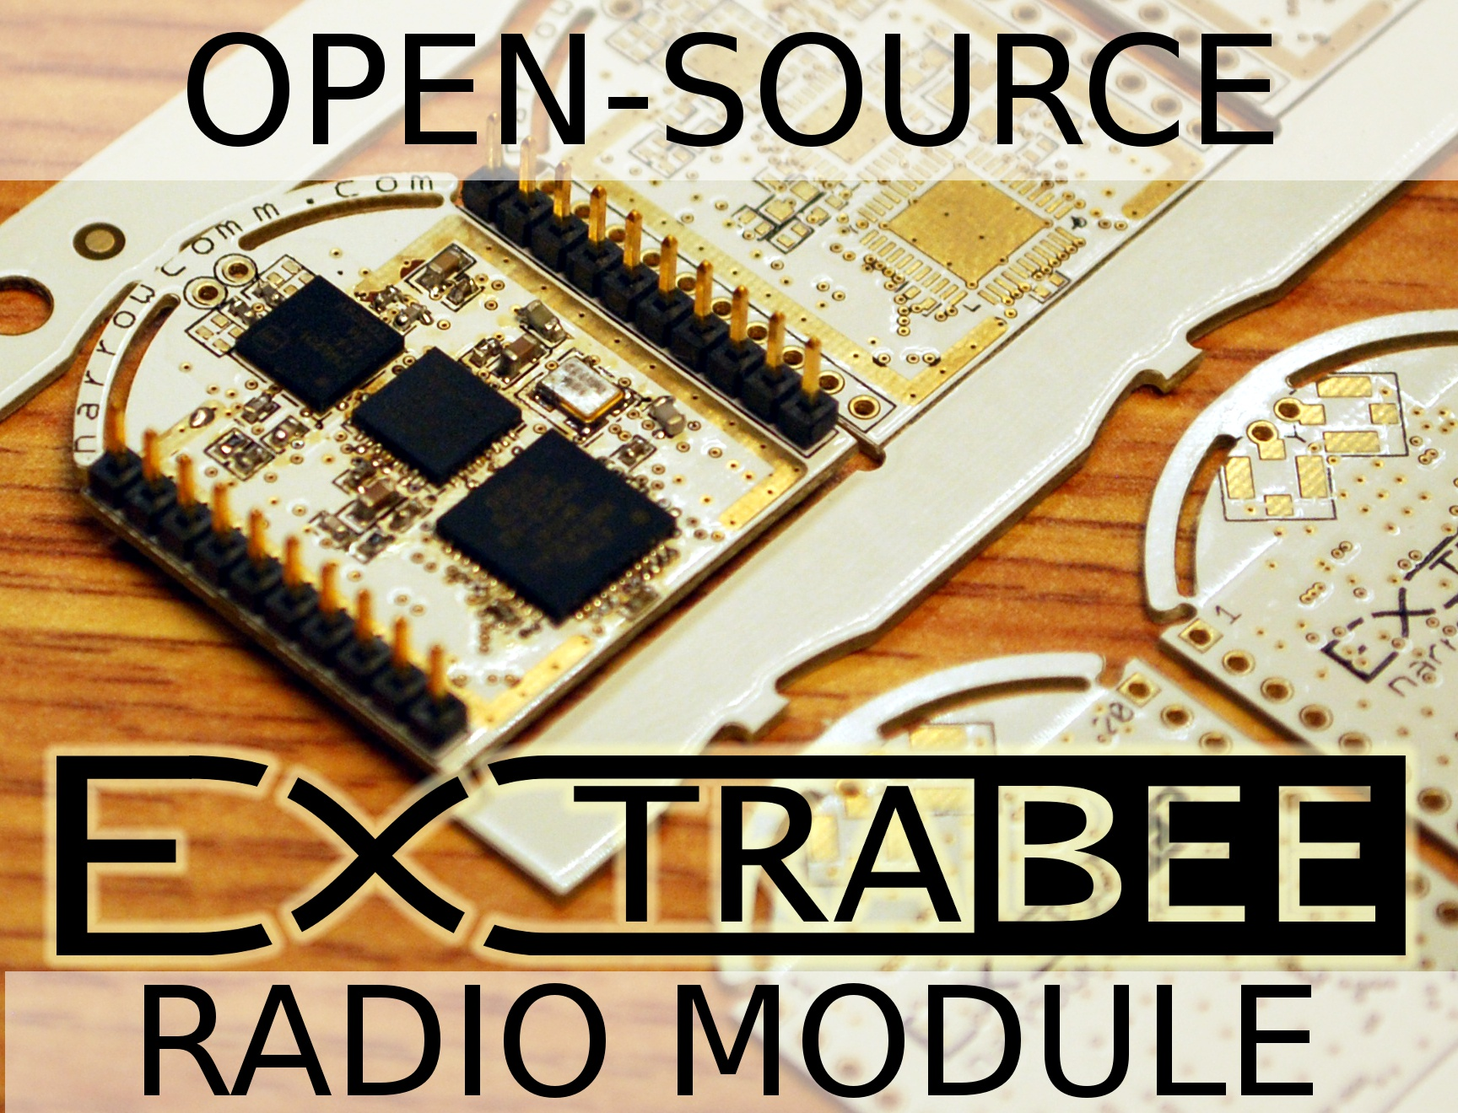
extrabee.org

Slide 2

What is a Radio Module?
data in/out, RF in/out
circuit board
power supply/regulation
micro-processor
radio transceiver
power amp for TX (some have this)
low noise amp for RX (some have this)
FCC certified (some have this)
open-source

Slide 3
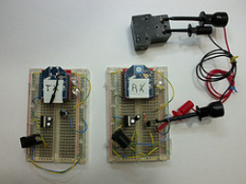
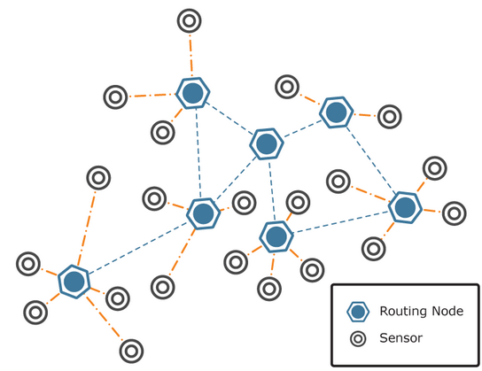
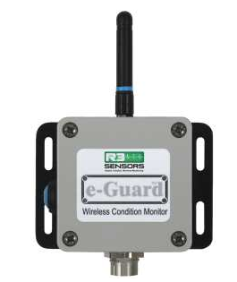
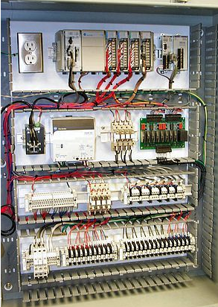
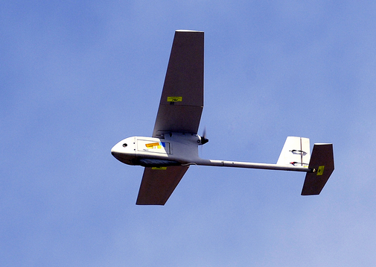
Applications for Radio Modules
Arduino-to-Arduino communication
Arduino-to-PC communication
Medium range Raspberry
Pi-to-device communication
Serial cable replacement
Digital I/O line passing
Quad-rotors and other aircraft
UAVs
Robots
Data loggers with remote access
Wireless sensors
Remote automation
Mesh networks

Slide 4




EXTRABEE Hardware
TWI
CPU
.4
USB
SPI
IRCOM
UART
DMAC
OSC
PLL
T/R
SW
BPF
DIV.
SW
ADC
AES/DES
DAC
FLASH
ADC
BPF
I/Q
MIX
BPF
GPIO
EEPROM
PWM
SRAM
Micro-processor
Radio Transceiver
Amplifier IC
Micro-processor

Slide 5
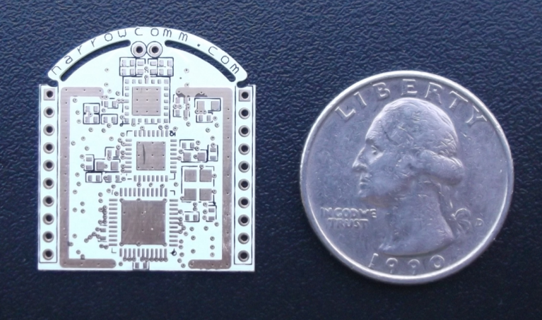
Small Size
Dual Spatial-Diversity Antennas
POWER AMPLIFIER/LOW-NOISE AMPLIFIER ANTENNA DIVERSITY
POWER AMPLIFIER/LOW-NOISE AMPLIFIER ANTENNA DIVERSITY
RADIO TRANSCEIVER
MICRO-PROCESSOR

Slide 6
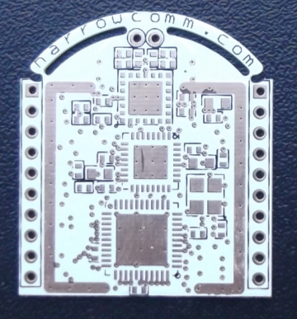
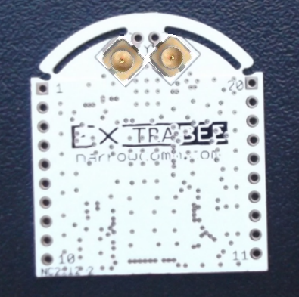
Three Antenna Options
WIRE MONOPOLE
ANTENNAS
INTEGRATED
ANTENNAS
EXTERNAL
ANTENNAS
SMALLEST,
SHORTEST RANGE
MOST EXPENSIVE,
LONGEST RANGE
INEXPENSIVE,
GOOD RANGE

Slide 7
Pin Signals
Power, Ground
Data in/out (USB, SPI, USART (w/ HW handshake), TWI)
Reset
2 PWM outputs
8 GPIO
5 ADCs (12-bit, 2MSPS, internal or external VREF)
2 DACs (12-bit, built-in cal., internal or external VREF)
RSSI
IrDA port

Slide 8
Performance
Operating Voltage: 2.1V to 3.5V
TX power: 200mW (+23dBm)
TX current 245mA @ 3.3V
RX sens -100dBm (<1% PER, 250kbps)
RX current 28mA (w/ LNA active)
Sleep current < 5uA(depending on sleep mode)
Range 100 ft – 2 miles (depends on antenna type and path type)
Data rate 250kbps

Slide 9
RF Protocols
The “language” spoken over-the air
Incompatible devices cannot communicate with each other
Popular ones:
  Bluetooth
  Wifi (IEEE 802.11...)
  IEEE 802.15.4
  Zigbee (802.15.4+mesh)
  Z-Wave
  WiMax
  ISA100 (802.15.4+)
  WirelessHART
  6LoWPAN
  Many Proprietary Protocols

Slide 10
Configuration
Sending “+++” invokes command mode
“AT” command set – à la dial-up modem
ATCH sets or reads the channel
ATID sets or reads the network ID
ATBD sets or reads the serial baud rate
Configuration can be saved to EEPROM so it will be non-volatile

Slide 11
Open-Source Firmware
Support and development community:
  http://extrabee.org
Source code hosted on Github:
  http://github.com/extrabee/extrabee
Present state:
  Basic command mode interface
  No bootloader yet, plan is to use an Arduino-compatible bootloader so it's easy to change the firmware

Slide 12
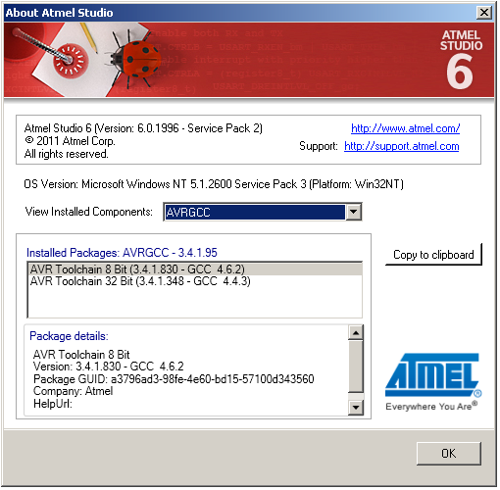
Development Environment
AtmelStudio 6
  AVR toolchain
  GCC compiler

Slide 13
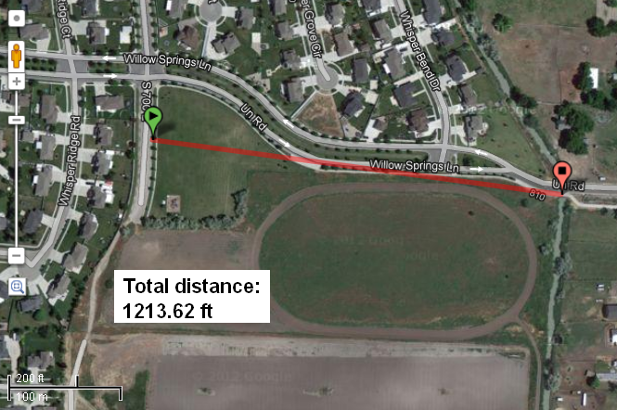
Prototype Range Test
City Park
1% PER

Slide 14
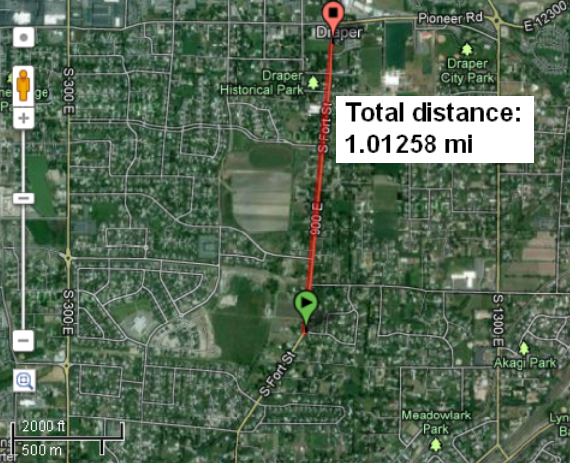
Prototype Range Test
Straight and Level Road with Traffic
40% PER

Slide 15
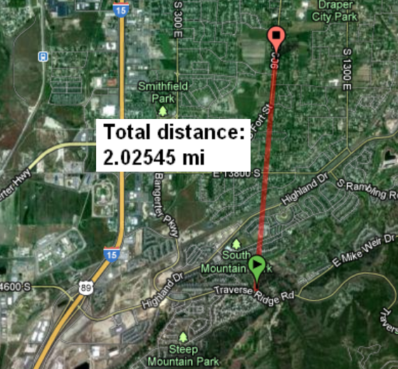
Prototype Range Test
Hillside Overlooking Valley
15% PER

Slide 16
Possible Future Features
Arduino compatibility – run sketches right on the Extrabee module
Packet sniffer mode
I/O line passing
RF channel scan command
Serial API instead of data pass-through
Encrypted packets over-the-air
Over-the-air firmware updates

Slide 17
FCC Approval
Any electronic device must be tested for FCC compliance for use in the US
“Intentional Radiators” must not cause interference to other devices (FCC Part 15)
Harmonics are generated at 2x, 3x, 4x... the main operating frequency
A test lab verifies that the device complies with FCC limits and issues a certificate
Testing is expensive

Slide 18
Kickstarter for FCC Test
Kickstarter campaign to pay for FCC test
The software is already open-source
Stretch goal on Kickstarter makes the hardware open-source too
http://kickstarter.extrabee.org

Slide 19

Demonstration

Slide 20


Need Help?
Visit Our User Forum: extrabee.org
Follow @ExtraBee on Twitter

